Slide 1
Microsoft Movie Studios - Movie Analysis
Phase 1 Project

Slide 2
Summary
This project uses exploratory data analysis which is an approach to analyse data to summarise their main characteristics and often with visual methods and this will generate movie insights for Microsoft Corporation. Microsoft's best-known software products are the Windows line of operating systems, the Microsoft 365 suite of productivity applications, and the Internet Explorer and Edge web browsers. Its flagship hardware products are the Xbox video game consoles and the Microsoft Surface lineup of touchscreen personal computers. Microsoft is always looking to diversify and venture into new business industries.

Slide 3
Outline
Business Problem
Data
Methods
Results
Conclusions

Slide 4
Business Problem
Microsoft sees all the big companies creating original video content and they want to get in on the fun. They have decided to create a new movie studio, but they don’t know anything about creating movies. In this project we will explore what types of films are currently doing the best at the box office. We will translate our findings into actionable insights that the stakeholders of Microsoft's new movie studio can use to help decide what type of films to create.

Slide 5
Data
In order to assist Microsoft's new movie studio in making informed decisions about the types of films to create, a comprehensive analysis of the current box office trends and successful film genres was conducted using data from Box Office Mojo. Box Office Mojo is a reputable online source that provides comprehensive information on box office performance, including domestic and international box office revenues, film genres, release dates, and critical reception. By analyzing the data from this platform, we aim to gain insights into the types of films that are currently performing well at the box office and identify potential opportunities for Microsoft's movie studio.

Slide 6
Data
The insights obtained from this data analysis will serve as a foundation for making informed decisions regarding the types of films that Microsoft's new movie studio should focus on. By understanding the current trends in the film industry and the genres that are resonating well with audiences, the head of the studio can strategically align their creative vision with the market demands, increasing the chances of producing successful and profitable movies.

Slide 7
Data
The movies dataset includes movies released from 2010 to 2018, and includes a wide variety of movie title, movie studio, movie genre, movie ratings, domestic and foreign gross. We used the data below:
Bom.movie_gross.csv.gz
Imdb.title.basics.csv.gz
imdb.title.ratings.csv.gz

Slide 8
Methods
This project uses exploratory data analysis which is an approach to analyse data to summarise their main characteristics and often with visual methods and this will generate movie insights for Microsoft Corporation.
For Visualizations we used Bar Graphs and scatter Graphs

Slide 9
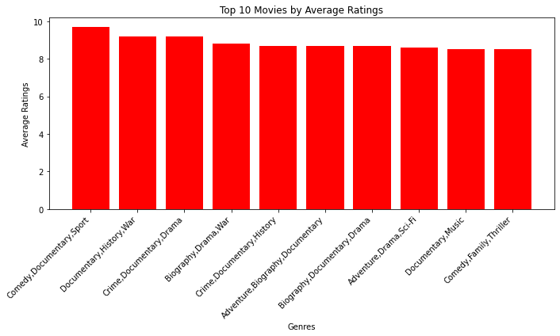
Results: Bar chart showing Top 10 Movies by Average Ratings

Slide 10
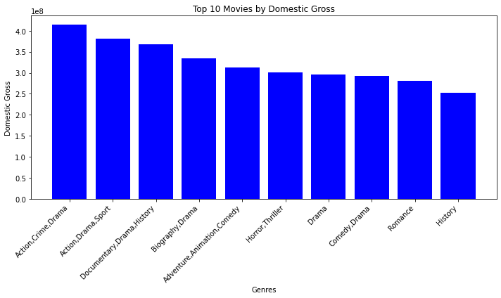
Bar chart showing Top 10 Movies by Domestic gross

Slide 11
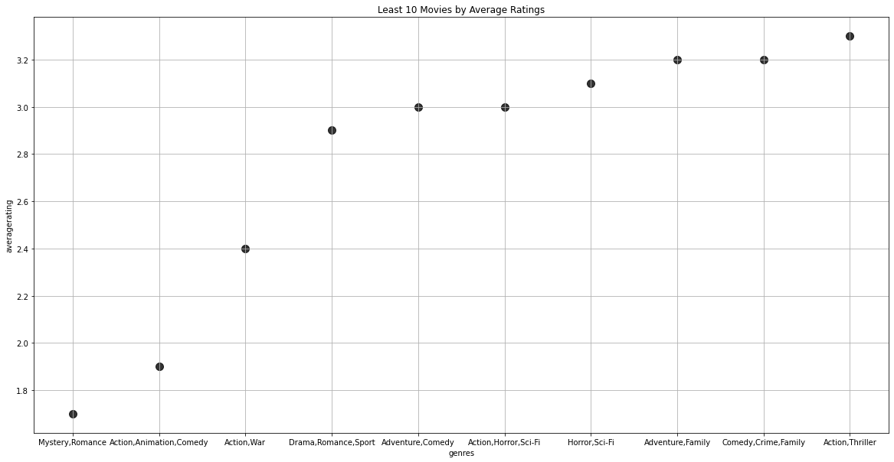
Scatter graph showing Least 10 Movies by Average Ratings

Slide 12
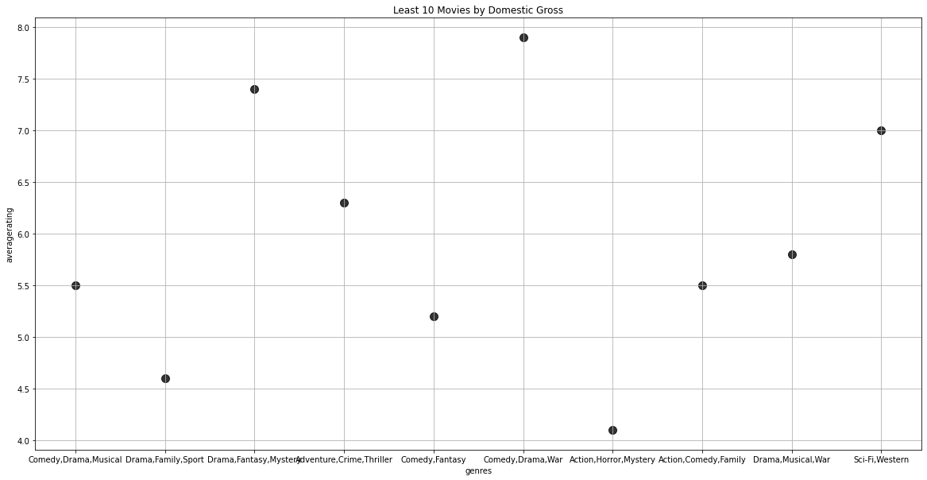
Scatter graph showing Least 10 Movies by Domestic gross

Slide 13
Conclusions
From our visualizations, we can see that 'Action,Crime,Drama' makes the highest gross and we can see that most of the genres with very high ratings also have low domestic gross. Hence, Microsoft should make movies based on domestic gross rather than ratings.

Slide 14
Thank You!
Email: stephen.kimiti@student.moringaschool.com
GitHub: @MuriraKimiti

